Slide 1
Sage 300 2017.1 Web SDK Overview
John Thomas (JT)
October 13, 2016

Slide 2
Component Updates
Kendo
Upgrade from 2014… to v2016.2.714
Azure SDK
Upgrade from 2.3 to 2.8
Target Framework
Upgrade from 4.5.1 to 4.6.2
Reference Updates
Misc. minor upgrades

Slide 3
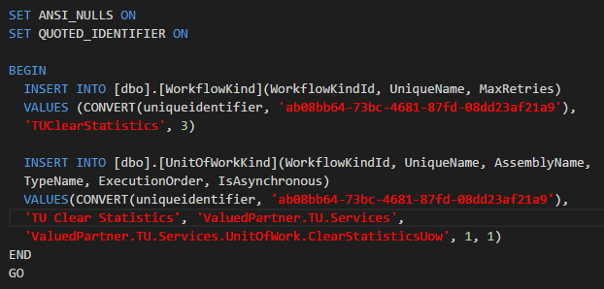
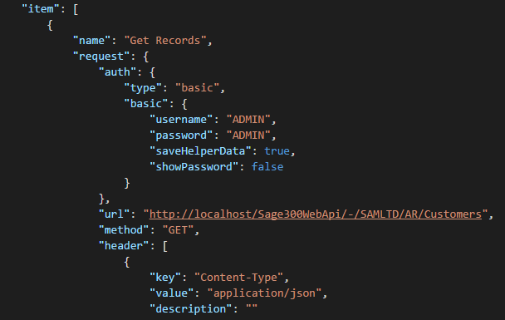
Samples
Source Journal Profile
Typo correction
Clear Statistics
New Process sample
Generates SQL script
WebApi Sample Integration
New WebApi sample
Includes docs
Includes Postman collections

Slide 4
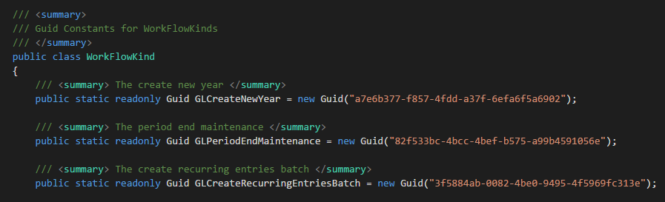
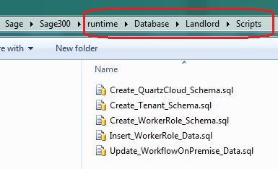
Process Enhancements
WorkflowKindIds changed to GUID from INT
Code Generation Wizard assigns new GUID
WorkflowKind Enum changed to constants
Landlord Database Worker Tables modified
LanlordDatabaseSetup.config file eliminated
..\runtime\Database\Landlord\Scripts now contains SQL scripts
Partner scripts discovery
Database Setup “Portal” Button functionality to interrogate this folder

Slide 5
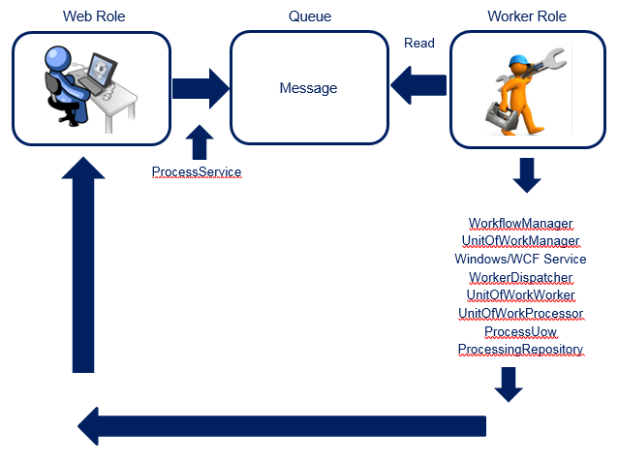
Documentation
New Worker Processing Document
New Architecture Brochure
New Customization Documents
Coming soon for December release
Web API Endpoint Updates
Coming soon with added endpoints
Web API Postman Instructions for Samples

Slide 6
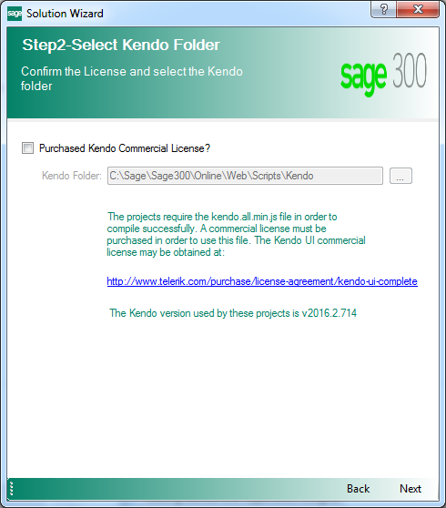
Solution Wizard
Kendo version upgrade
Only one Kendo file required copying
Azure SDK upgrade
Target framework now 4.6.2
Updated references

Slide 7

Code Generation Wizard
Target framework now 4.6.2
Updated references
Process code Type
Generates all code files
Now generates SQL script
WorkflowKindId now GUID
New Worker Processing Document
Minor defect corrections

Slide 8

Solution/Project Upgrades
Sage300SDK_2017UpgradeInstructions.docx
Coming soon!
Component upgrades
Reference changes
Target framework upgrades
New files added to Web Project for better CSS compatibility
OptionsMenu Changes to “key” areas of screen
…

Slide 9
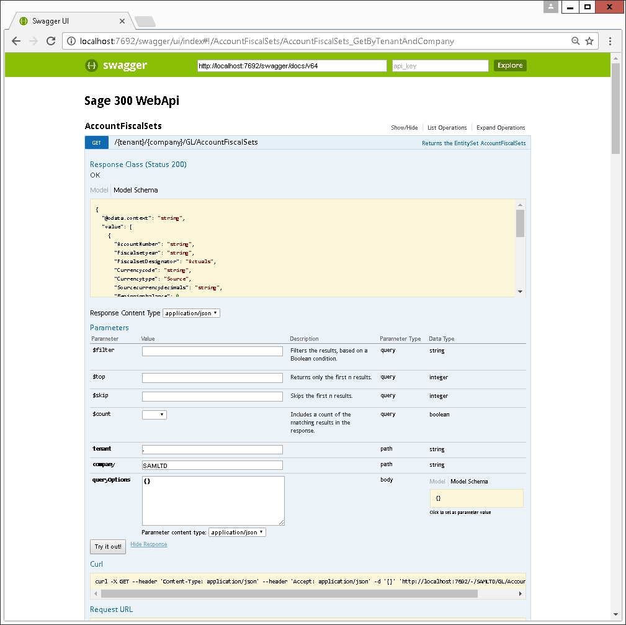
Web API
OData Upgrade
Asp.Net Odata Library V5.9.1 which supports OData Version 4.0
PATCH Support at Detail Levels
UpdateOperation Property
Versioning
http://localhost/Sage300WebApi/v1.0/-/SAMLTD/BK...
OpenAPI Documentation
Swagger
Added Endpoints
Feature Endpoints for SIRC Support
http://localhost/Sage300WebAPI/v1.0/FR/-/SAMLTD/…

Slide 10

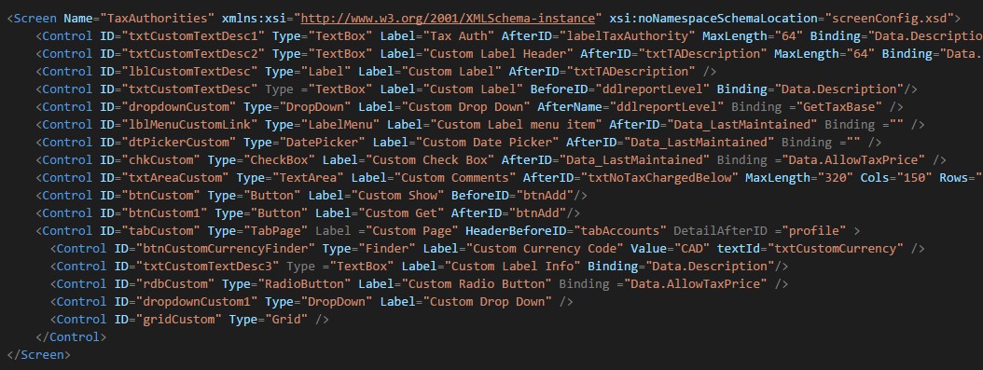
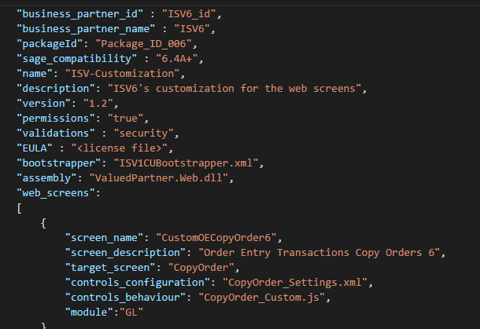
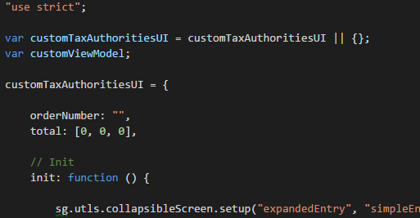
Developer Persona – Creating a Customization
I want to customize a screen by adding control(s) by creating the required manifest and XML document(s) along with any associated JavaScript.

Slide 11




Developer/Partner Persona – Bundling a Customization
I will zip my JSON, XML and JavaScript in order for the Customization Administrator to import my customization.

Slide 12


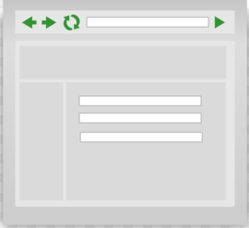

Partner/Administrator Persona – Importing a Customization
I want to import my customization into Sage 300 through the Customization Administrator Task, which will consume my zip file and apply it to the Sage 300 database.

Slide 13

Partner/Administrator Persona – Managing a Customization
I have the opportunity to enable or disable my customization, change the order in which my customization is applied in a screen because multiple customizations may exist and even delete the customization from the system. A customer can now have multiple customizations per screen

Slide 14

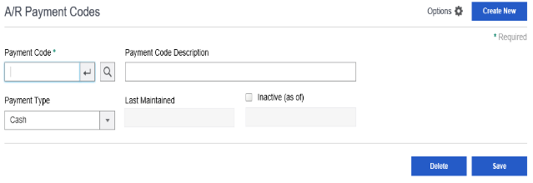


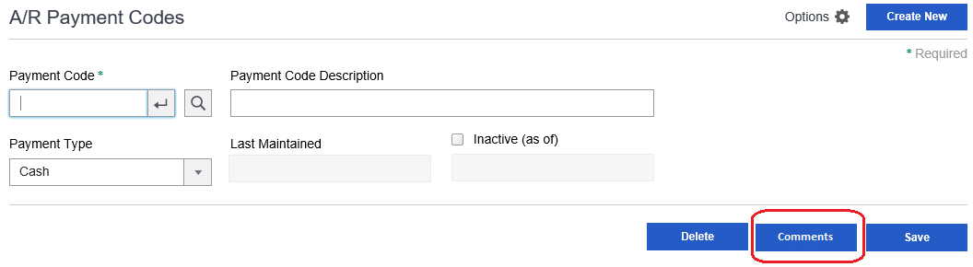

User Persona – Using a Customization
I can’t wait to see how the customization will look once it is applied!

Slide 15
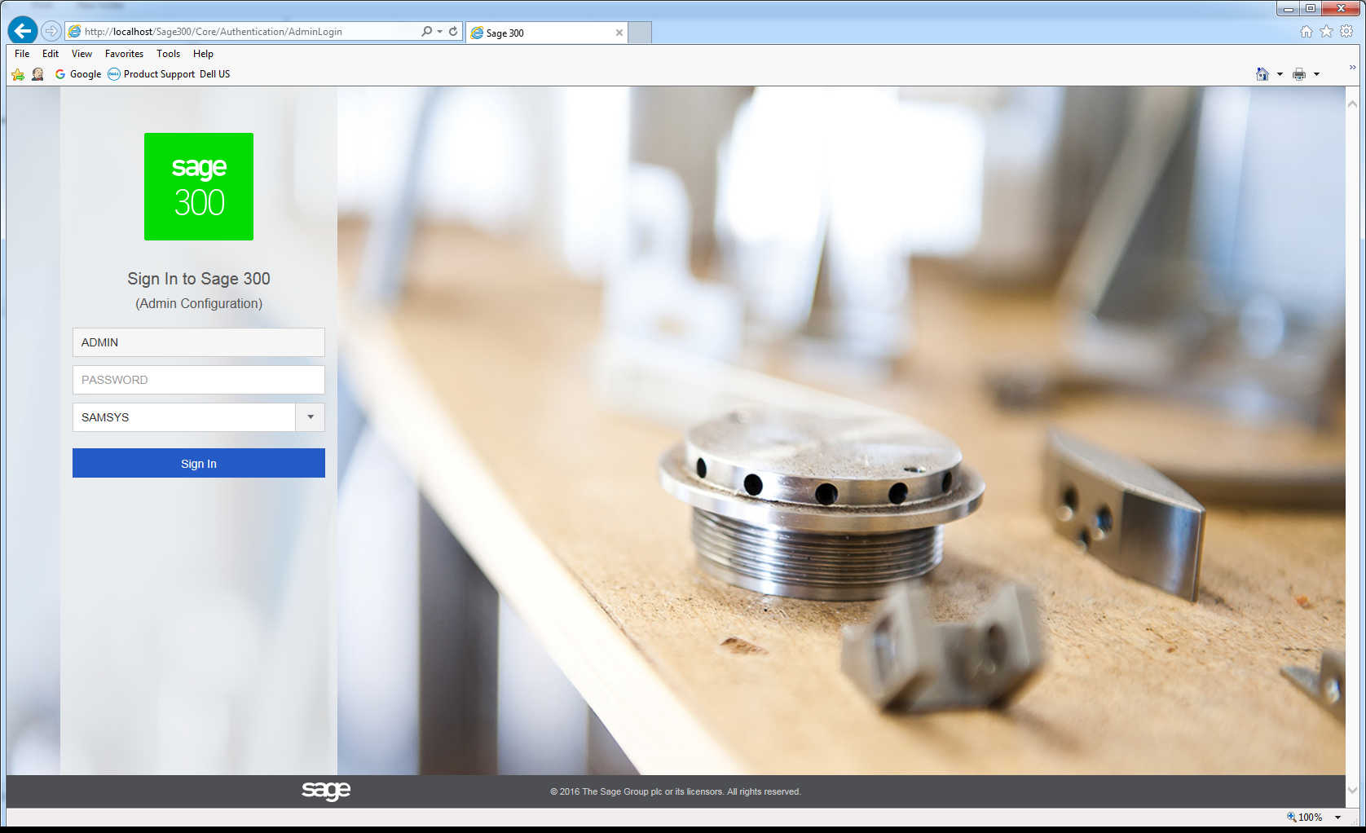
Customization Demo

Slide 16
GitHub Repository
Open Source
https://github.com/SageNADev/Sage300-SDK
Beta for 2017.1 is available in “develop” branch

Slide 17
Known Issues
Web API
Updated documentation coming
Customization
IIS Virtual Folder not being created by installer
Conversion Document/Process
Currently in-progress

Slide 18
Sage 300 2017.1 Web SDK Overview
Questions?
Beta 1

